Slide 1
Multi-Wavelet Residual Dense Convolutional
Neural Network for Image Denoising
GuideName: Ms.K Vani Prasanna
Batch no. - CSEBNUM_H13
221810308031 Saiteja namani
221810308036 Parvathaneni Kaushik
221810308030 Nagavelli Rohith Kumar
221810308060 Yerra Abhinav Goud

Slide 2
Index
What is Image Denoising
What are Convolutional Neural Networks
What is Discrete Wavelet Transform (DWT)
DWT to IDWT
Architecture
Dataset
Software and Hardware
References

Slide 3
What is Image Denoising
It is a process to reserve the details of an image while removing the random noise from the image as far as possible.
Types of Image noise:
Gaussian Noise
Salt and Pepper Noise
Speckle Noise
Poisson Noise

Slide 4
What are Convolutional Neural Networks?
Convolutional Neural Network (ConvNet/CNN) is a Deep Learning algorithm which can take in an input image, assign importance (learnable weights and biases) to various aspects/objects in the image and be able to differentiate one from the other.
It requires less pre-processing when compared to other classification algorithms.
While in primitive methods filters are hand-engineered, with enough training, ConvNets have the ability to learn these filters/characteristics.

Slide 5
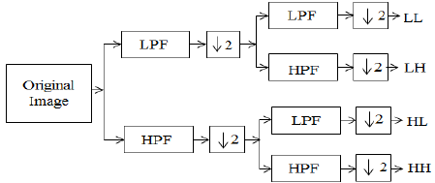
What is Discrete Wavelet Transform?
A discrete wavelet transform (DWT) is a transform that decomposes a given signal into a number of sets, where each set is a time series of coefficients describing the time evolution of the signal in the corresponding frequency band.
LL - Approximation Image
LH - Horizantal Edges
HL - Vertical Edges
HH - Diagonal Edges

Slide 6
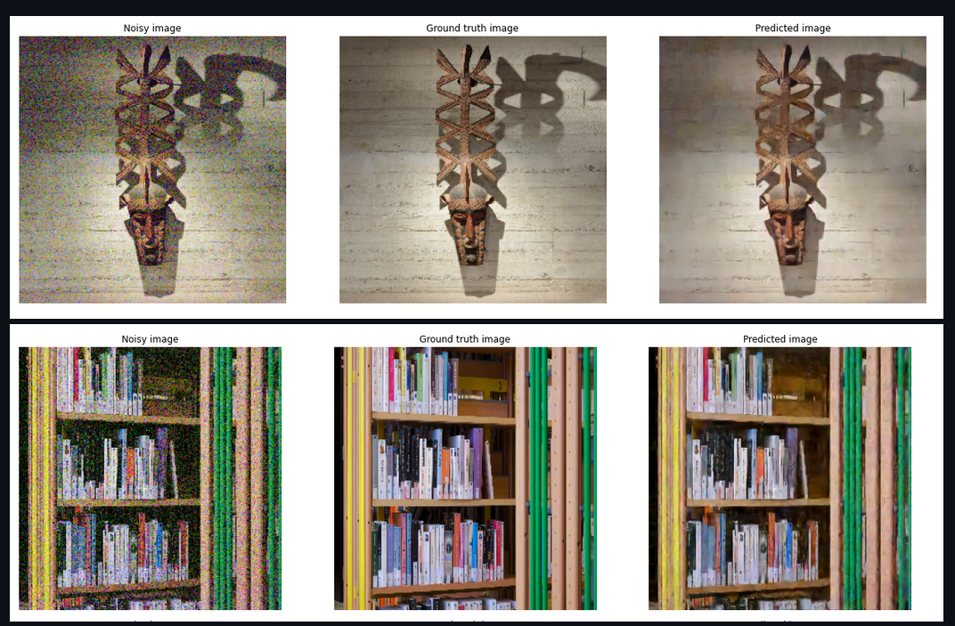
Project output examples

Slide 7
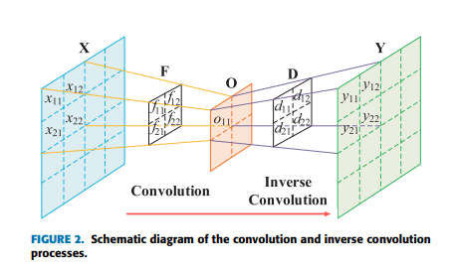
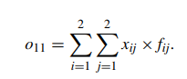
DWT to IDWT

Slide 8
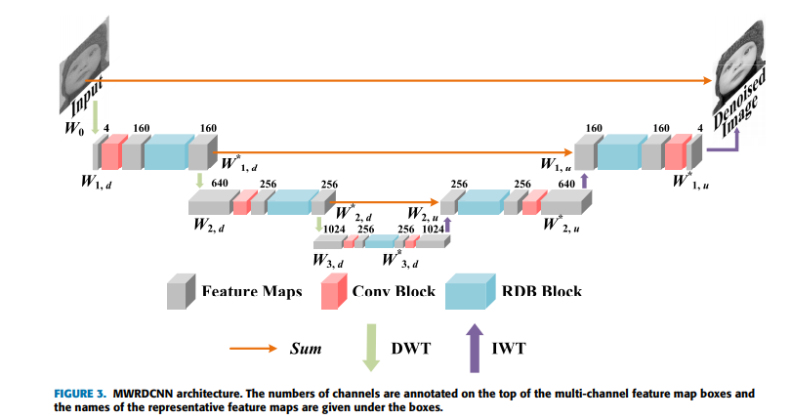
Architecture(MWRDCNN)

Slide 9
Dataset
The DIV2k(one of the most popular training sets benefiting from its high quality) is used here. It contains 800 images for training, 100 images for validation.
https://www.kaggle.com/sharansmenon/div2k

Slide 10
Software and Hardware used:
Cpu: Intel i7/(10th gen)
Gpu: Nvidia rtx 2070
Ram: 16gb
Software:Programming lang - Python-3.9
Python libraries used
-Keras,Tensorflow,Numpy,Pandas,OpenCV.

Slide 11
Review 2
Project Flow
Importing necessary Libraries
Defining Image DeNoise Function
Injecting noise into the Image
Converting Image to Float
Denoising the image using Wavelet Transform
Displaying Noisy and Denoised Image

Slide 12
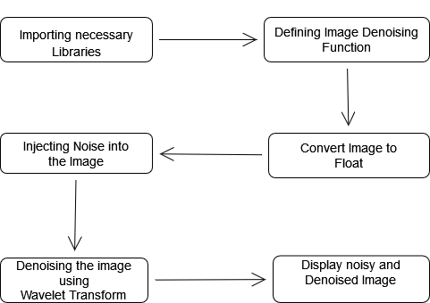

Slide 13
Required Libraries
Matplotlib : Matplotlib is a low level graph plotting library in python that serves as a visualization utility.
Opencv : OpenCV is a library of programming functions mainly aimed at real-time computer vision. Originally developed by Intel, it was later supported by Willow Garage then Itseez.
SkImage : Scikit-image, or skimage, is an open source Python package designed for image preprocessing.

Slide 14
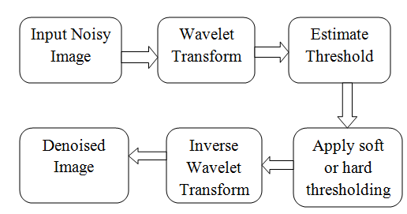
Model we used
Bayes shrink function and visushrink functions

Slide 15
Multi-Wavelet Model Parameters
Random_noise - predefined function to inject noise
Estimate_sigma - predefined function for estimating noise
Denoise_wavelet - predefined function for performing wavelet transform
Peak_signal_noise_ratio - used to calculate psnr value
All these are imported from Skimage package.

Slide 16
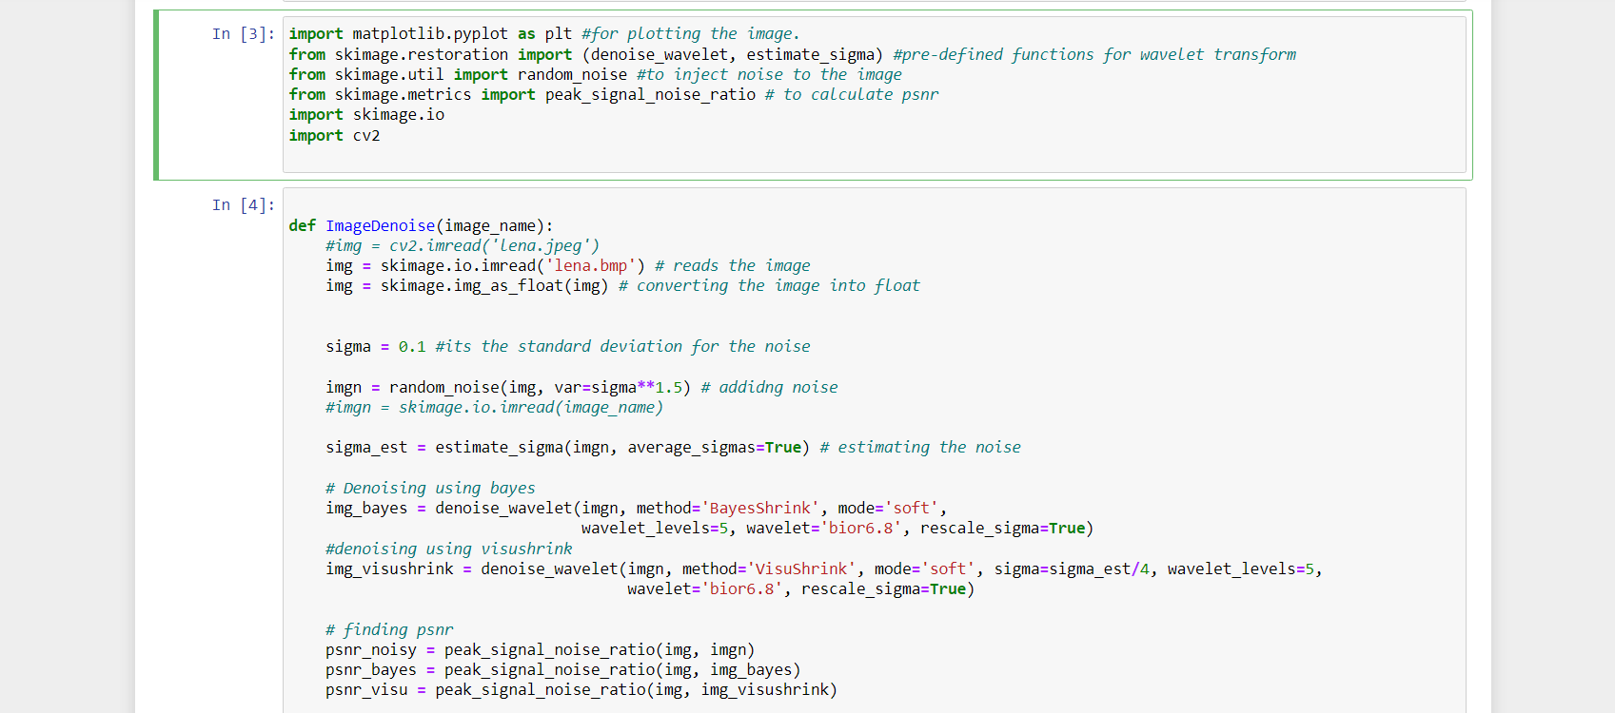

Slide 17
Review 3

Slide 18
Autoencoders:
Autoencoders are an unsupervised learning technique in which we leverage neural networks for the task of representation learning. Specifically, we'll design a neural network architecture such that we impose a bottleneck in the network which forces a compressed knowledge representation of the original input.

Slide 19
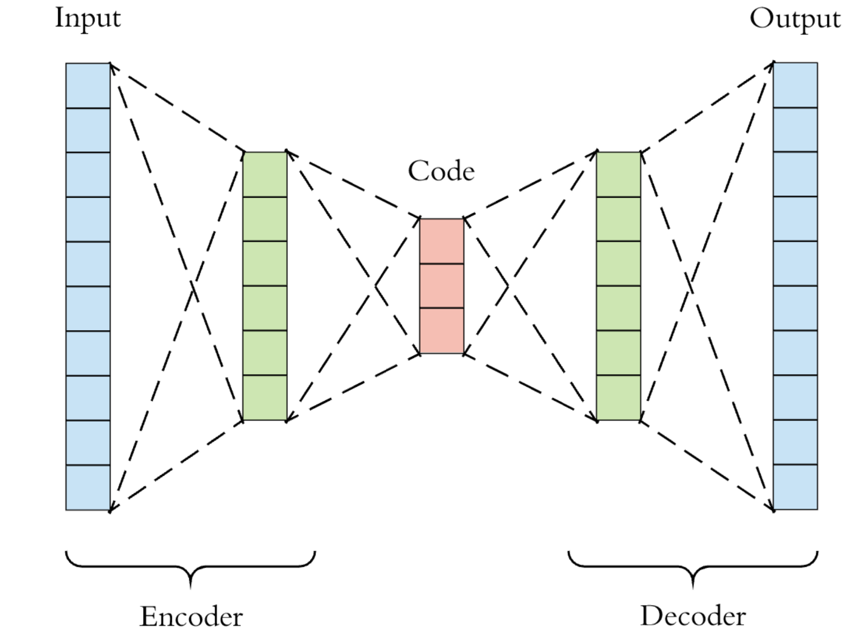

Slide 20
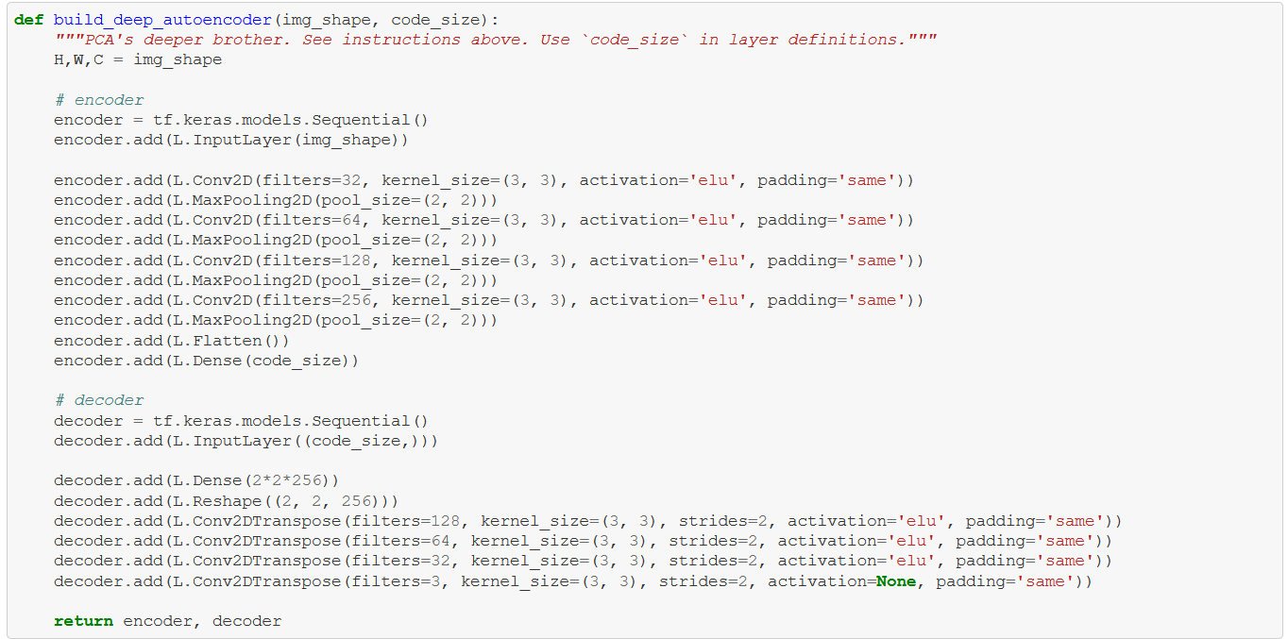

Slide 21
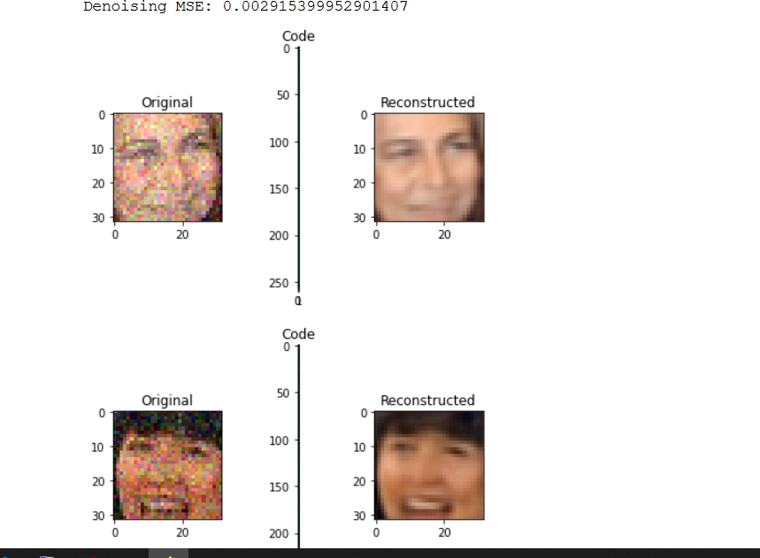

Slide 22
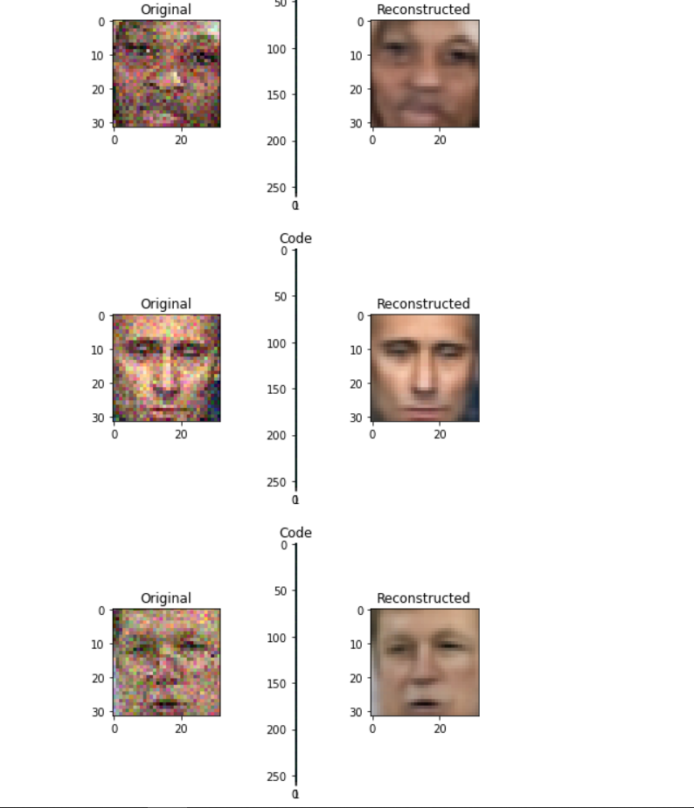

Slide 23
Impact of this project
This project will help us to improve the quality of the images by decreasing noise.
Can be helpful for professional photographers.
Can be helpful for the medical industry( denoising the mri scans etc..)

Slide 24
References
Base paper: https://ieeexplore.ieee.org/document/9270032/authors#authors
Data set: https://www.kaggle.com/sharansmenon/div2k
https://pub.towardsai.net/image-de-noising-using-deep-learning-1a8334c81f06

